Slide 1
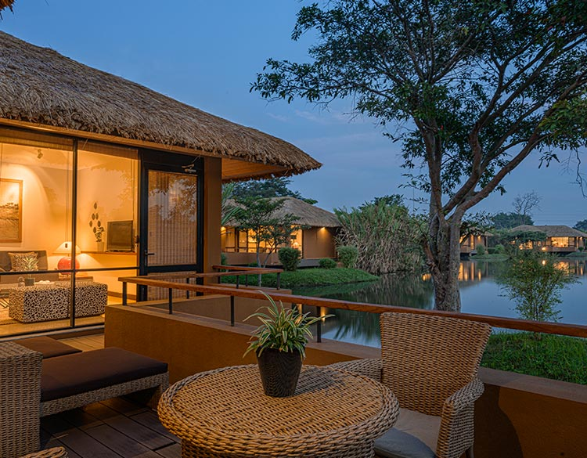
Natural Hotels

Slide 2
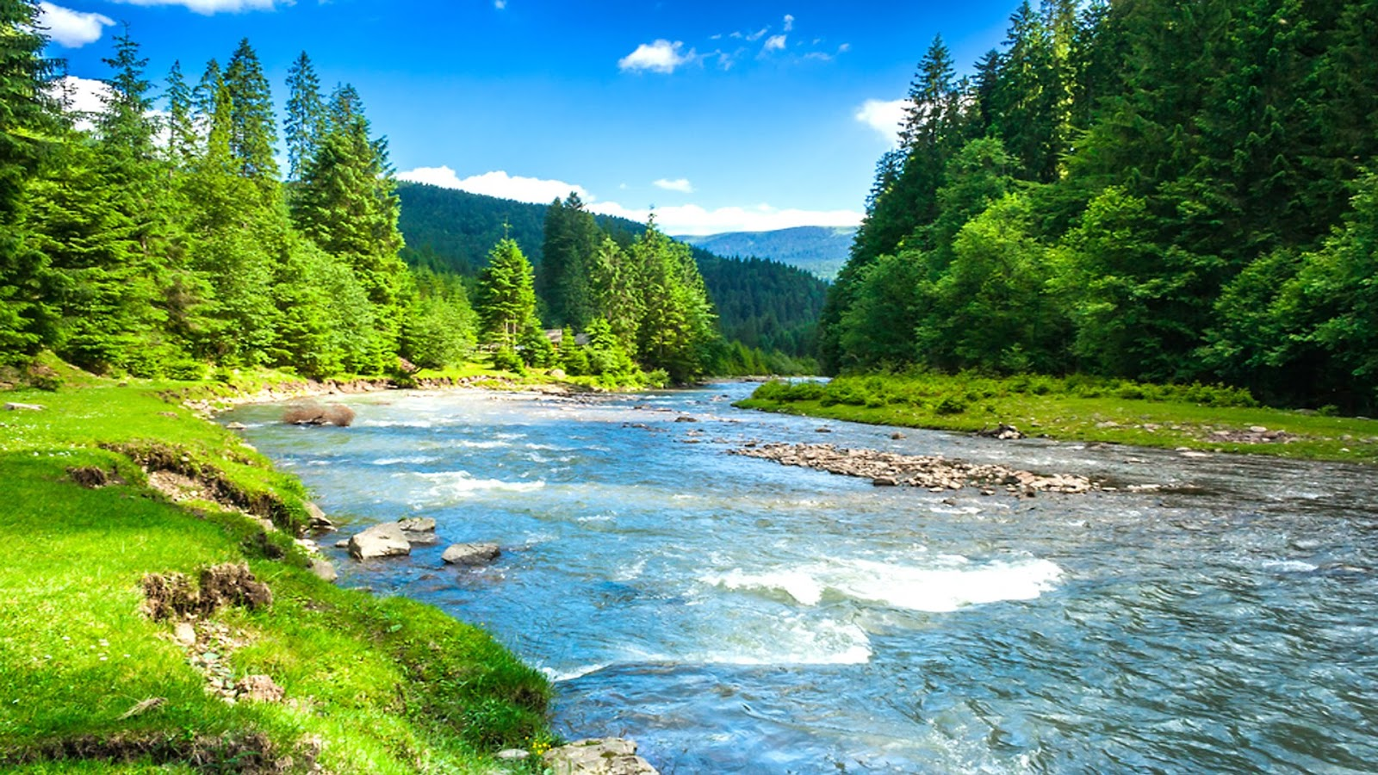
5 Group Members
SkyWalkers
13 pages

Slide 3
Our web site Process
Natural Hotels
Home
Contacts
About Us
Vacation
Day Out
Beachside Hotels
Riverside Hotels
Forestside Hotels
Mountainside Hotels
Beachside Hotels
Riverside Hotels
Forestside Hotels
Mountainside Hotel

Slide 4
Compere Hotels Packages
Different Location
Offers
Basic details about hotel

Slide 5
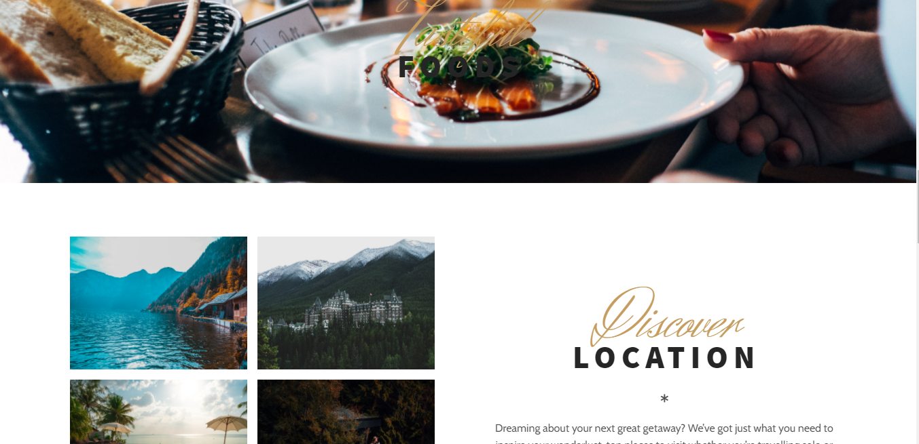
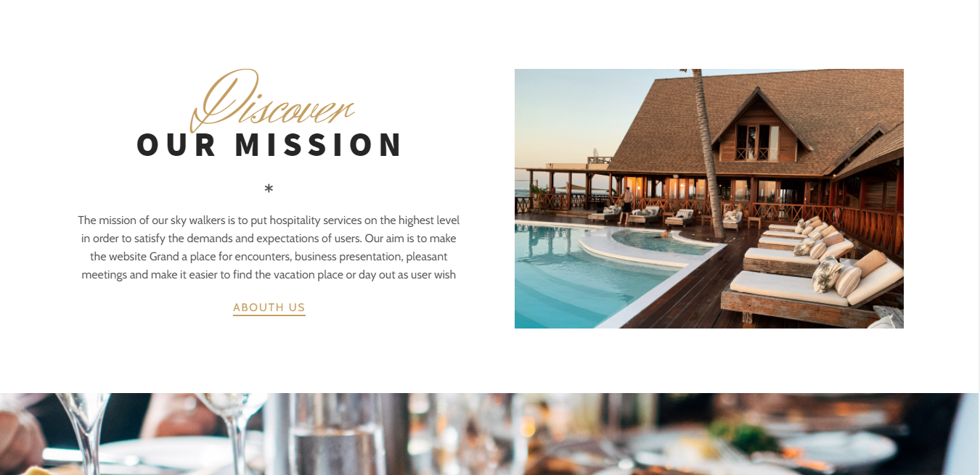
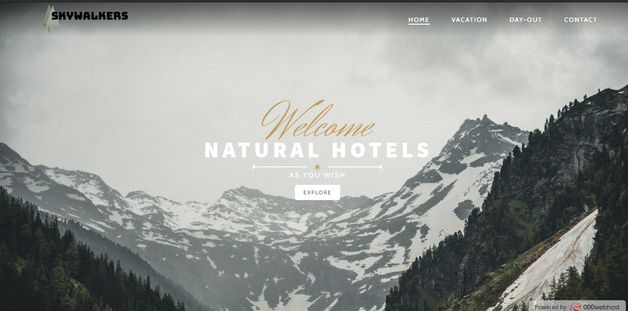
Main Web Page

Slide 6
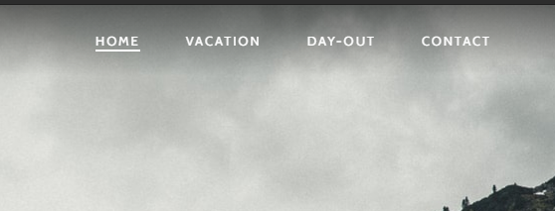

Sub Main Web Pages
Natural resorts and hotels to spend Vacations.
Visitors can see our self definition.
Natural resorts and hotels to spend
Day-Outs.
Visitors can contact us.

Slide 7
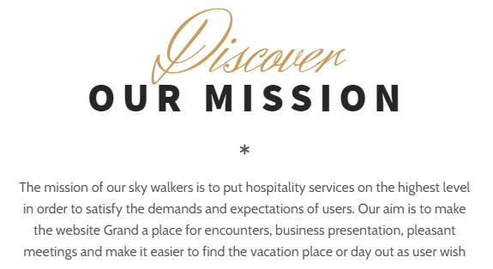
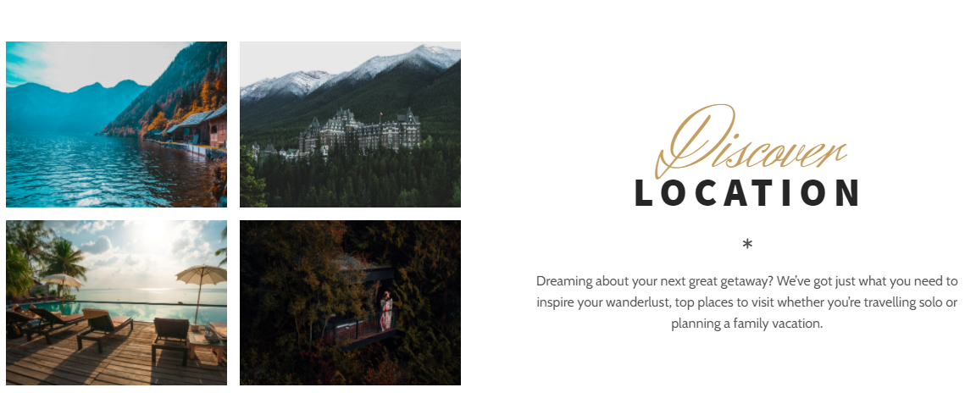



Slide 8
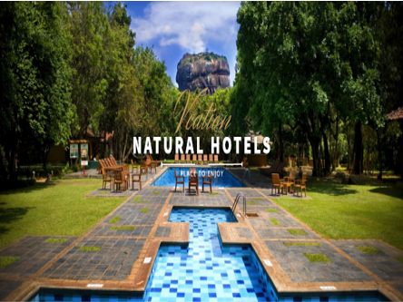
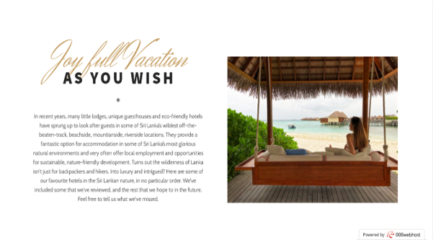
Vacation Web Page

Slide 9
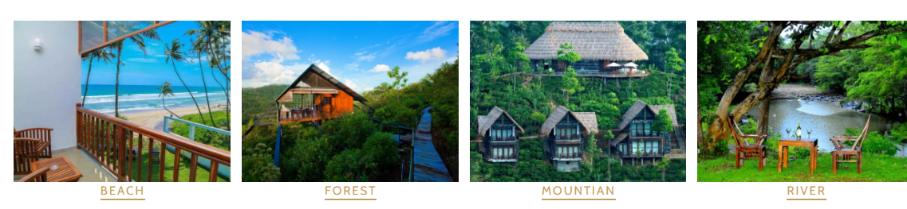
Through the Vacation web page..
Cheap amount natural hotels and luxury hotels also
Very comfortable packages
Visitors can make different choices as they wish from -:

Slide 10
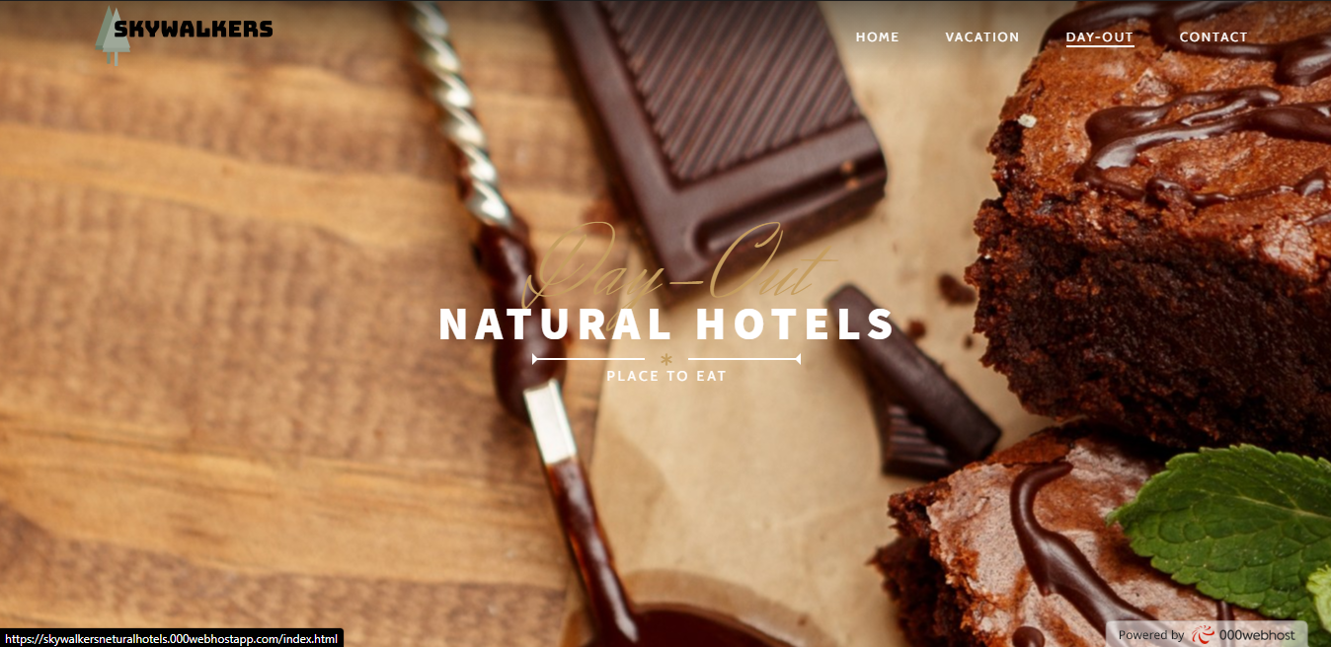
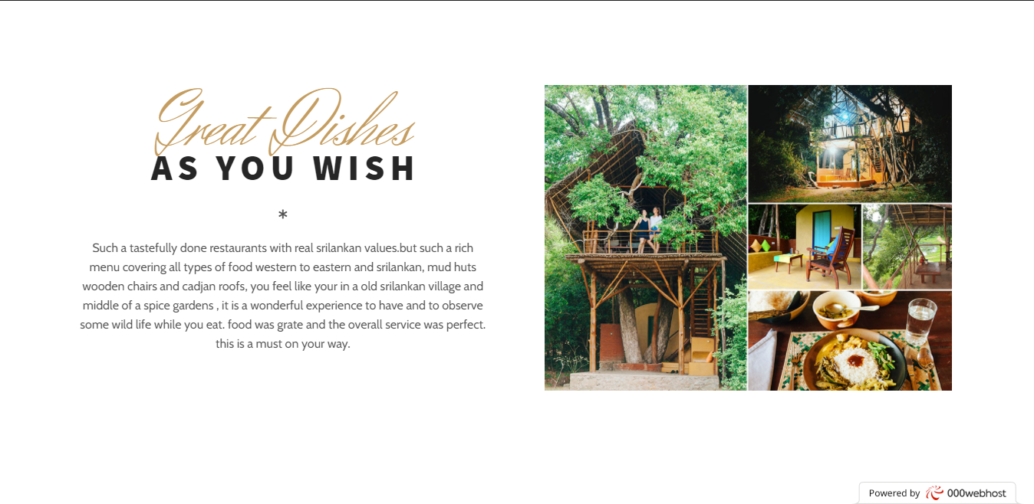
Day-Out Web Page

Slide 11
Through the Day-Out web page..
Very delicious meals
Surprise parties, Birthday parties..
Have the meals with nature
Visitors can make different choices as they wish from -:

Slide 12
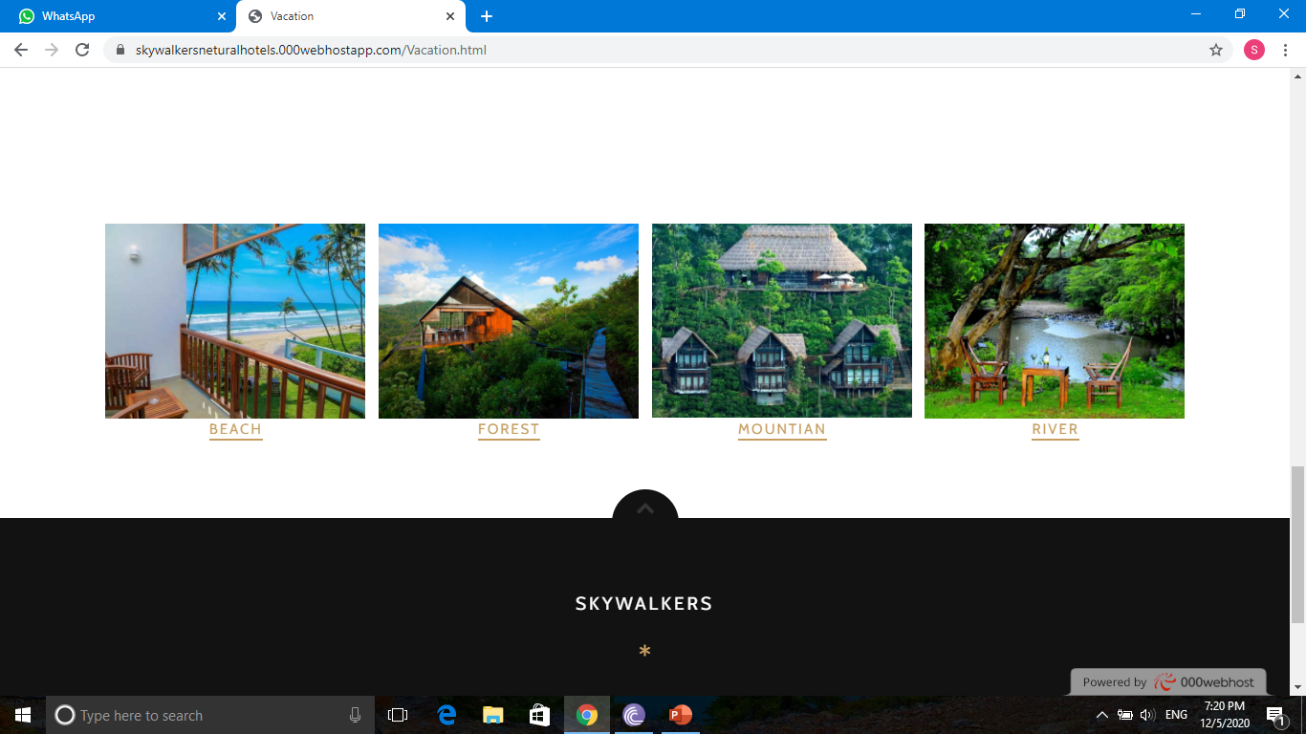

Slide 13
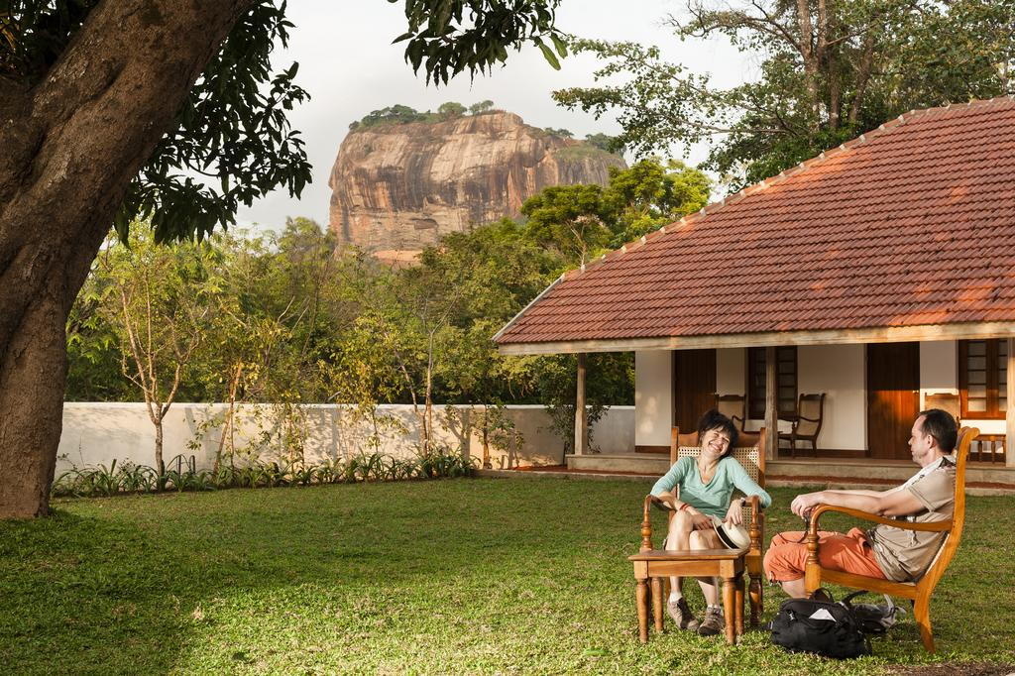
Vacation

Slide 14
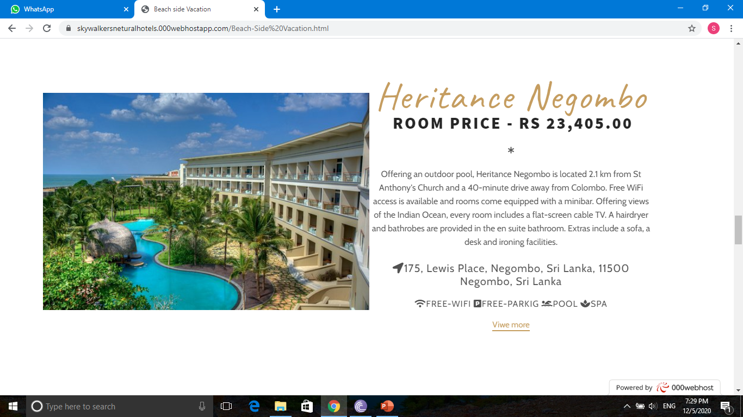

Slide 15
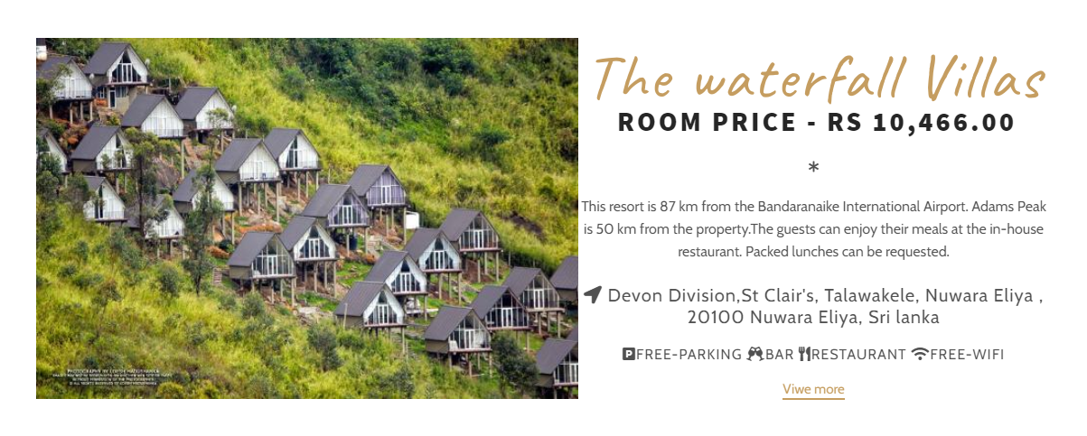

Slide 16

Day Out

Slide 17
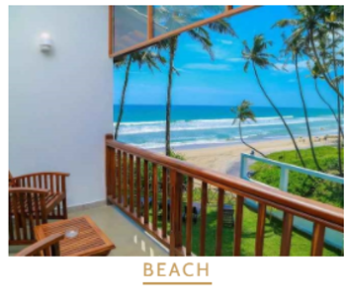
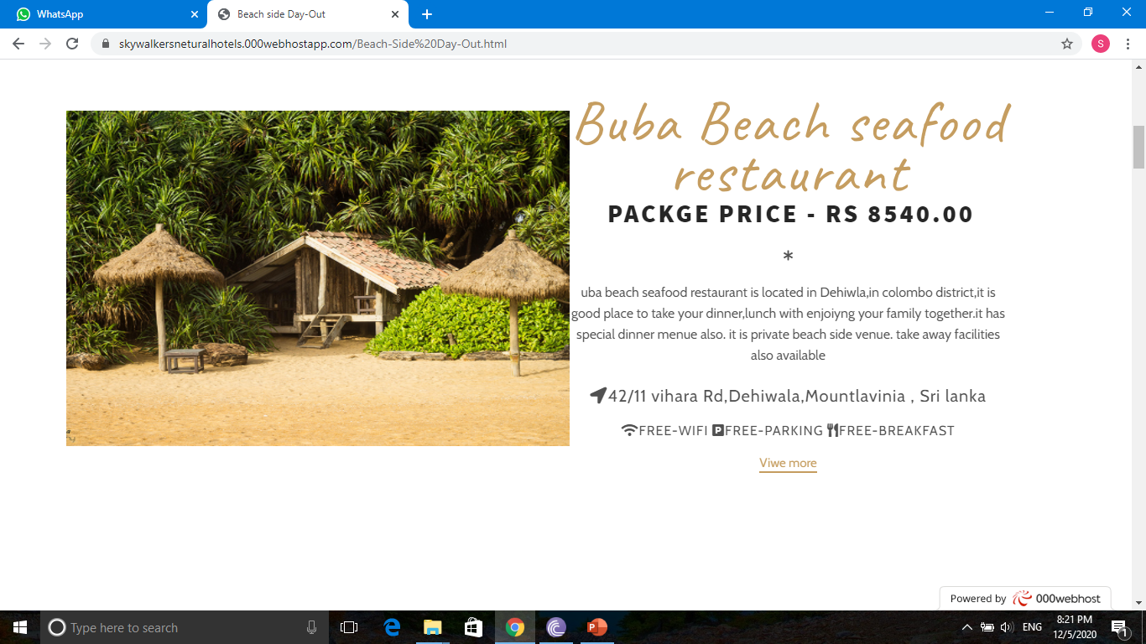
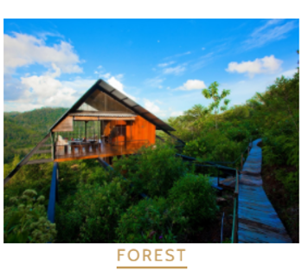
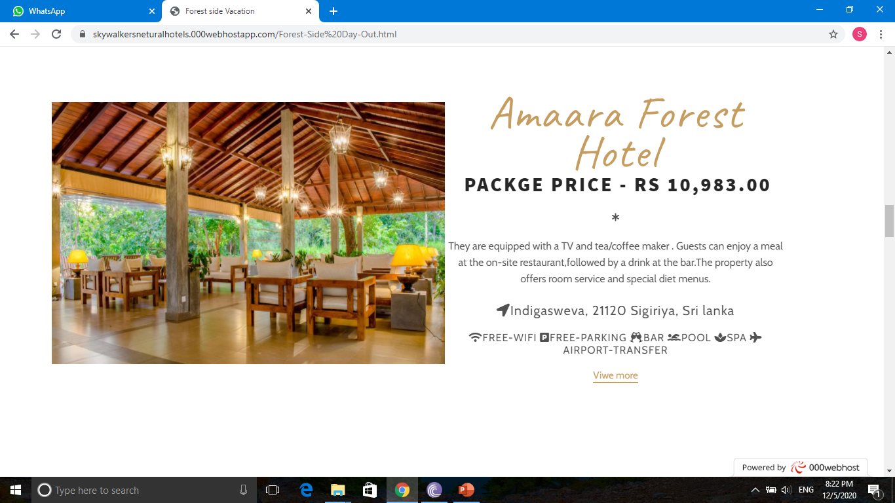

Slide 18
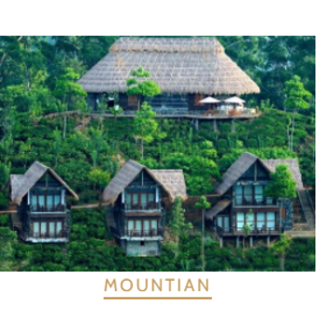
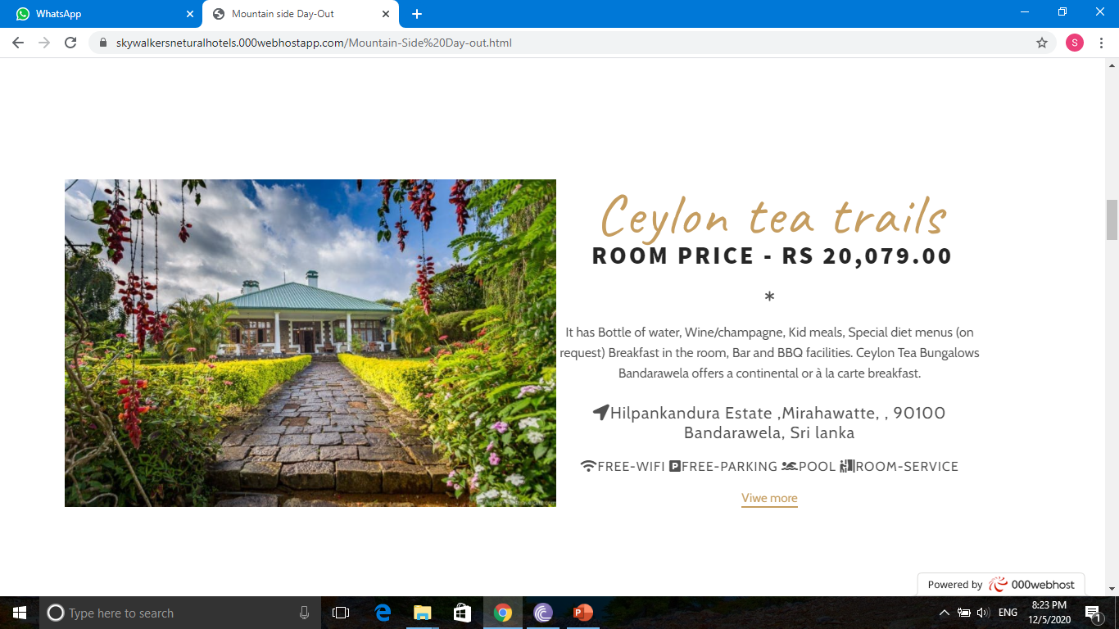
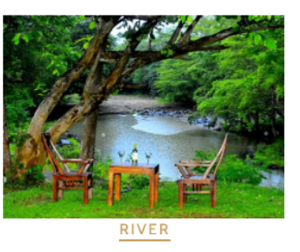
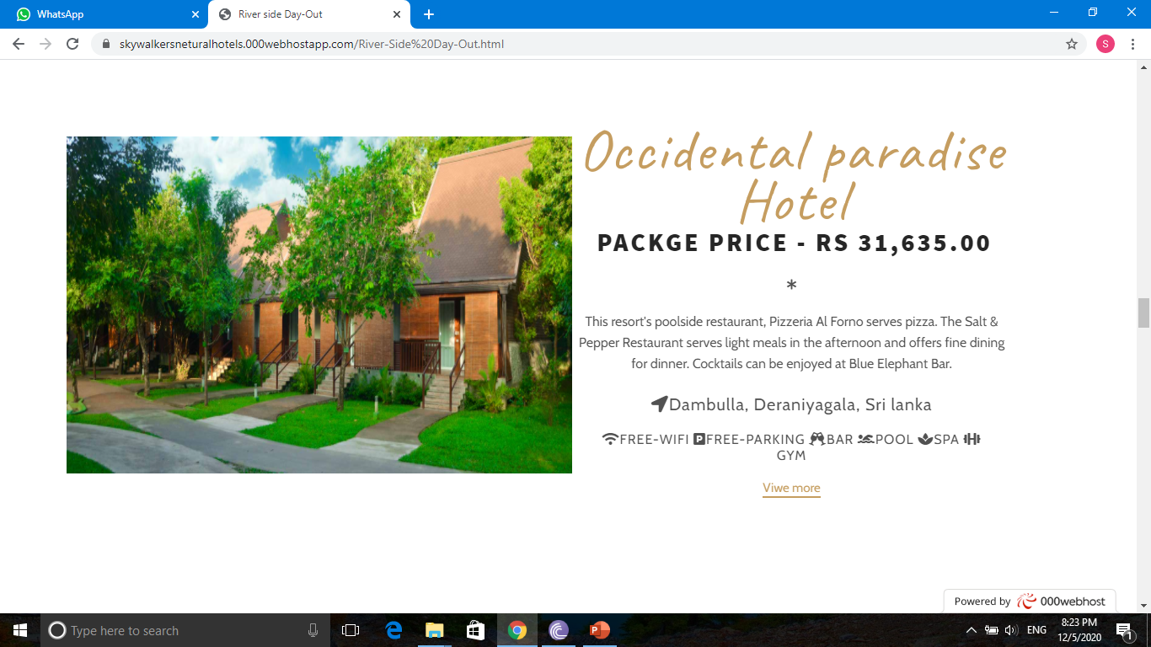

Slide 19
The Importance of our Web site
Easy to find nature hotels suitable for nature lovers for vacation and day out.
Depending on the individual, it can be selected as beachside hotels, riverside hotels, mountain side hotel and forest side hotels.
Quickly and easily gain an understanding of room prices, packages prices, packages details, facilitate and other details.
Consumer time and labor savings.
Very attractive and appealing.
Being able to choose the perfect choice for the most comfortable accommodation.

Slide 20
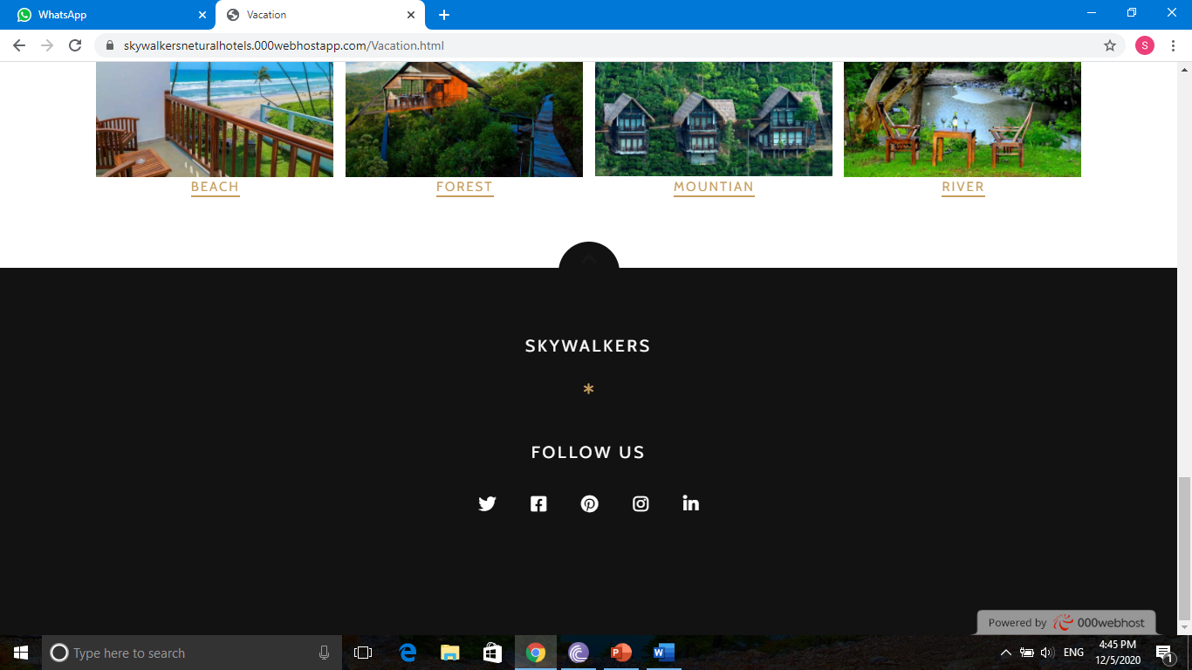
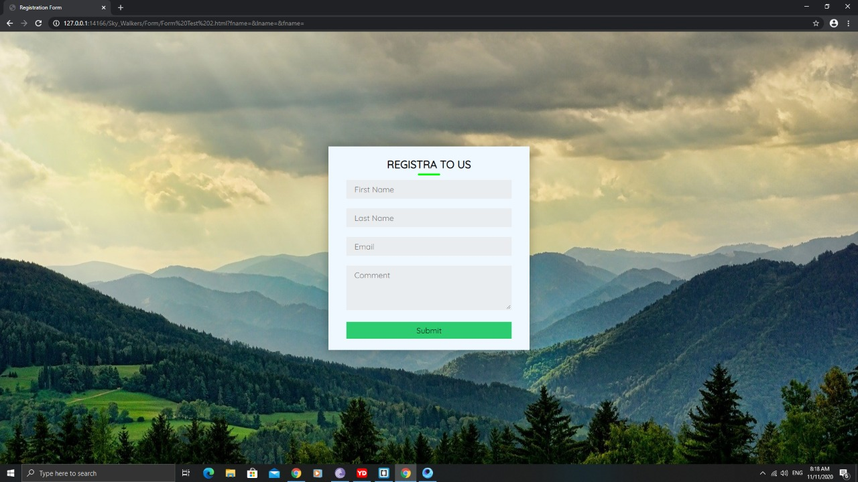
Contact Us
Email Address
Phone Number
Form
Face book

Slide 21

IMPROVEMENTS
If we talk about our future improvements in our Skywalkers hotel website ,we will hope to develop in different features and resources. Adding the feature of directly booking to a vacation or day out place according to that the user choice. In this situation our website have around fifty vacation and day out places and we hope to develop this website in wide area including whole country. We hope to improve new updates of our website for our new users. We hope to inform offers that gives the hotels included in our website for our users. We will develop our website 100% user friendly online booking engine and make easier to access for our daily users. We will develop the ability to compare and contrast room and rates

Slide 22

Thank you

